Slide 1
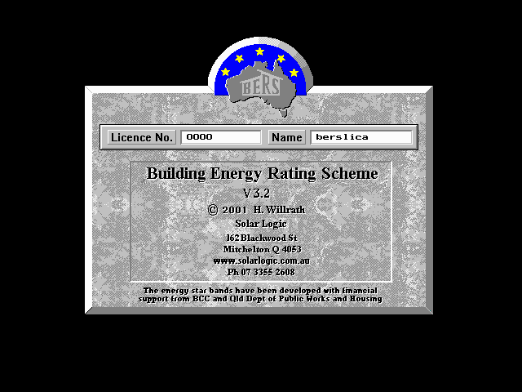
BCGSV5013A
Apply principles of energy efficient design to buildings
Version and licence details

Slide 2
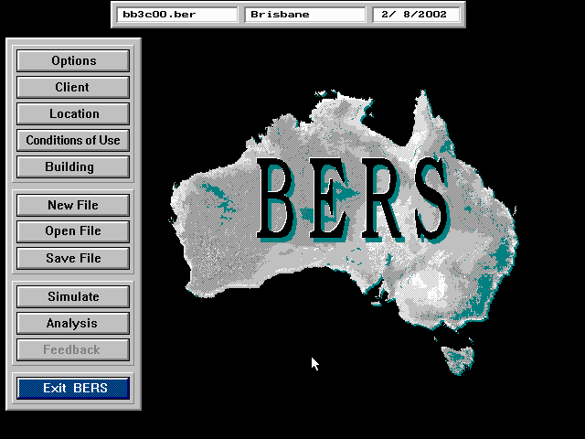
The main menu

Slide 3
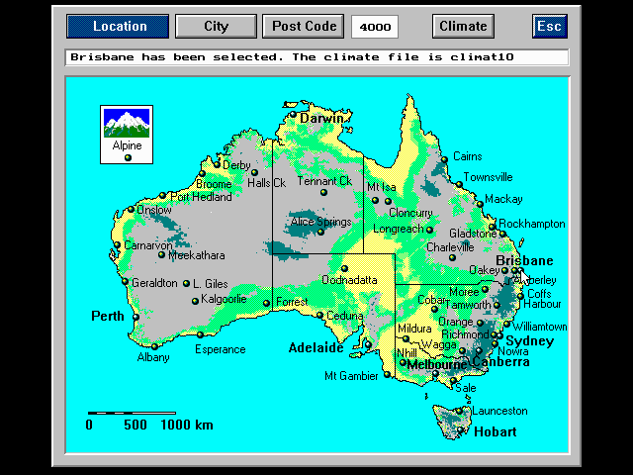
Selecting the location

Slide 4
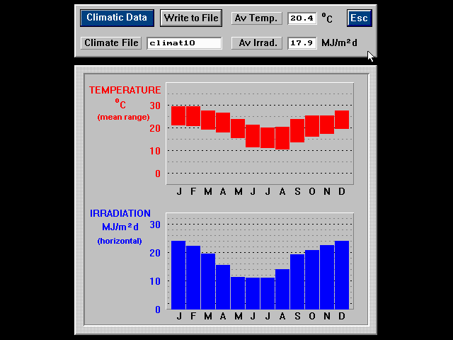
Inspecting the data in the selected climate file

Slide 5
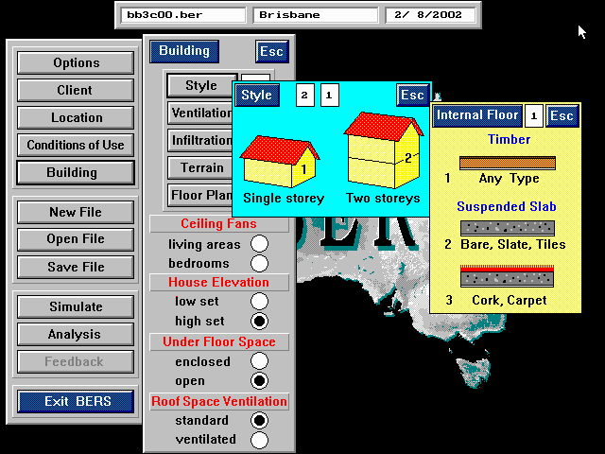
Selecting the number of levels

Slide 6
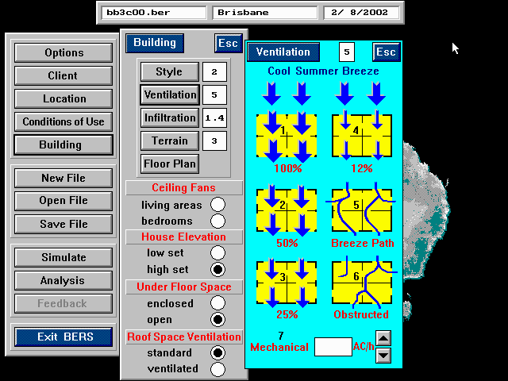
Selecting the ventilation type

Slide 7
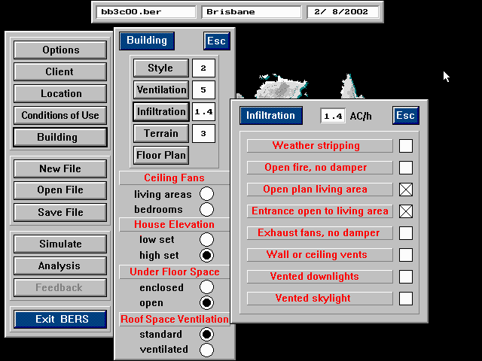
Selecting the degree of infiltration

Slide 8
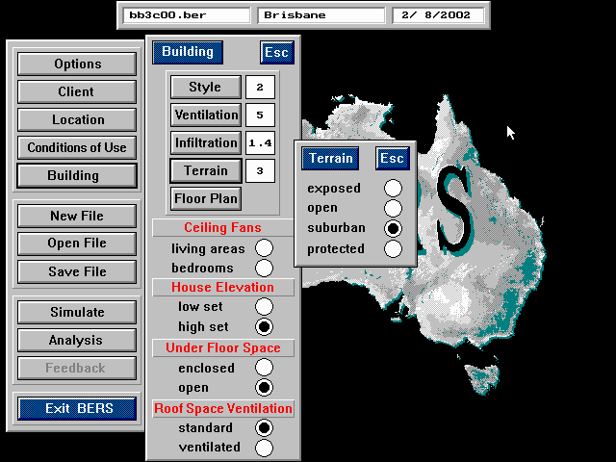
Selecting the terrain type

Slide 9
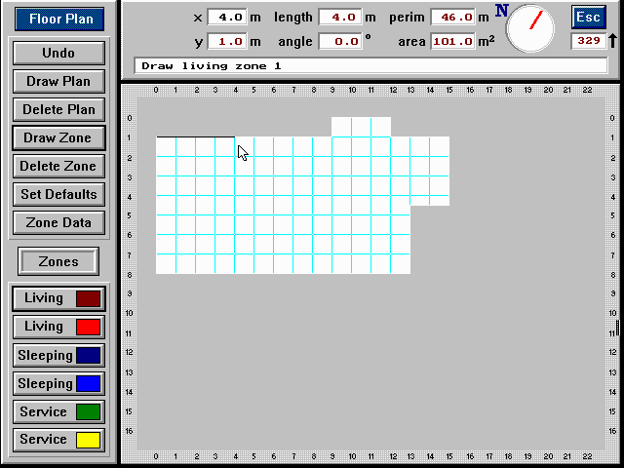
Drawing the plan and zones

Slide 10
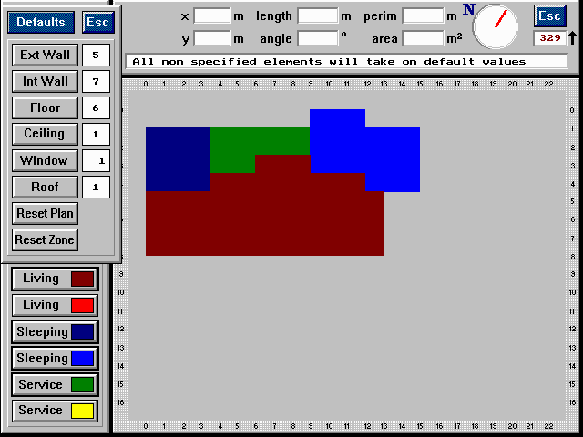
When the plan is drawn and zoned, default values can be selected

Slide 11
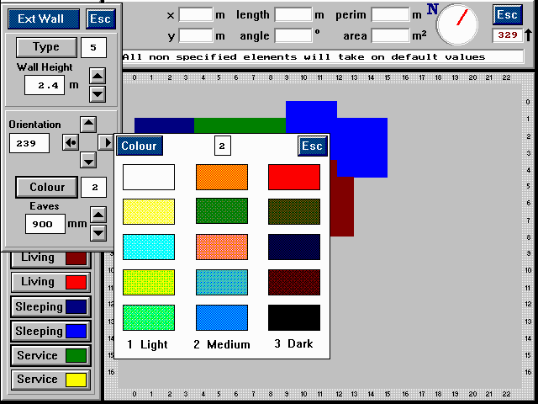
Selecting a default external wall colour

Slide 12
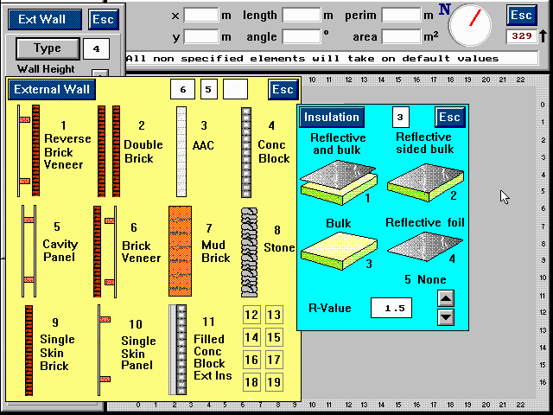
Selecting a default external wall type and insulation

Slide 13
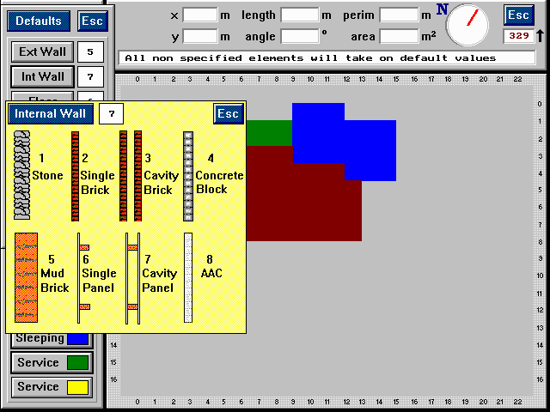
Selecting a default internal wall type

Slide 14
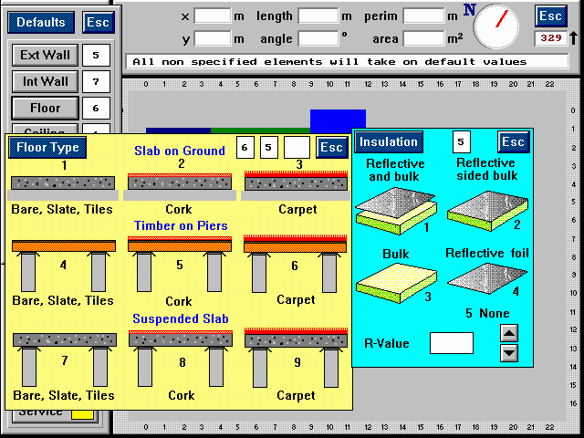
Selecting a default floor type, floor covering and insulation

Slide 15
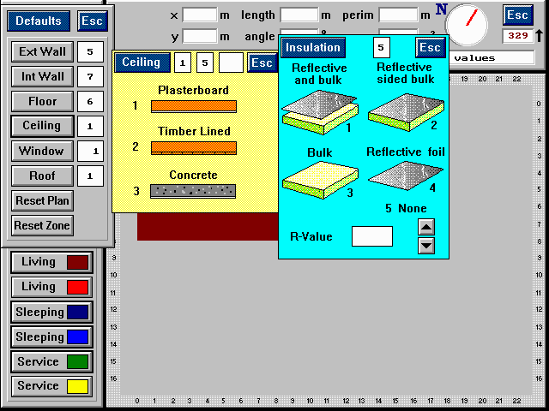
Selecting a default ceiling and insulation type

Slide 16
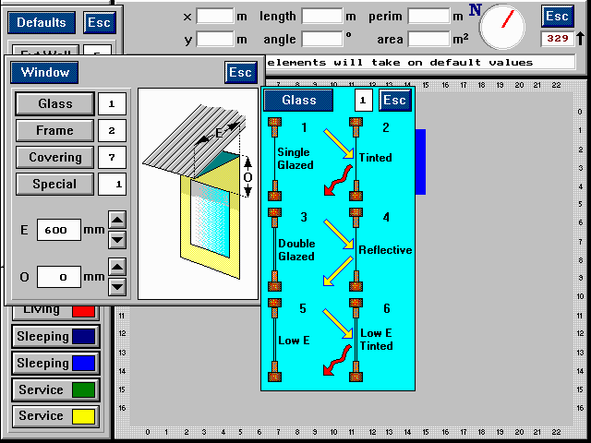
Selecting a default generic window glass

Slide 17
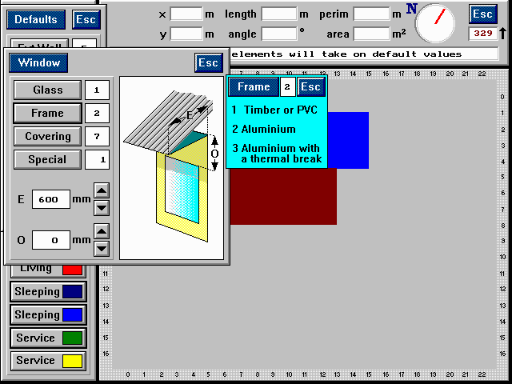
Selecting a default generic window frame

Slide 18
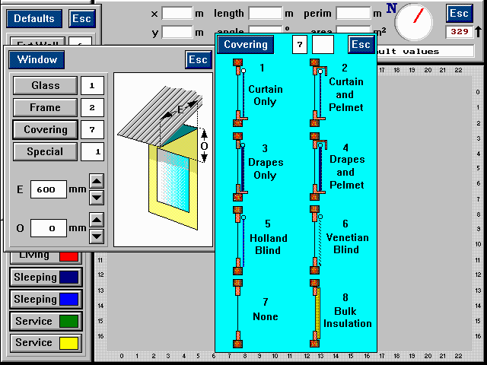
Selecting a default window covering

Slide 19
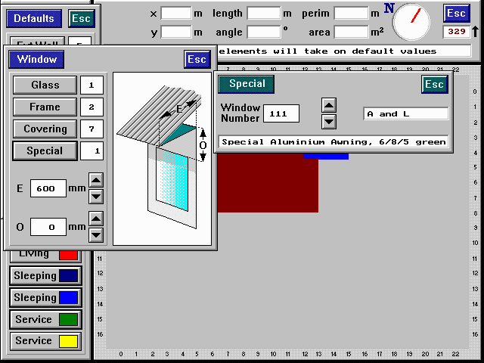
Selecting a default proprietary window

Slide 20
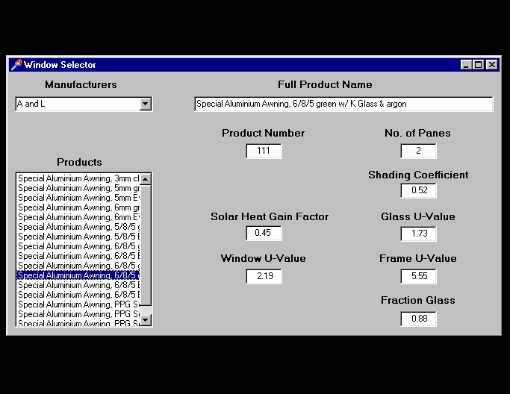
Examining the properties of proprietary windows using the BERS Window Selector

Slide 21
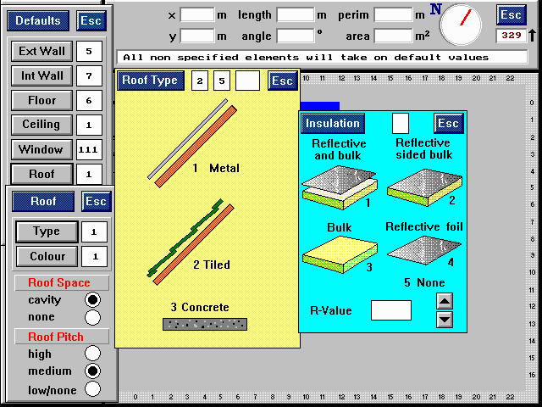
Selecting the roof type and insulation type

Slide 22
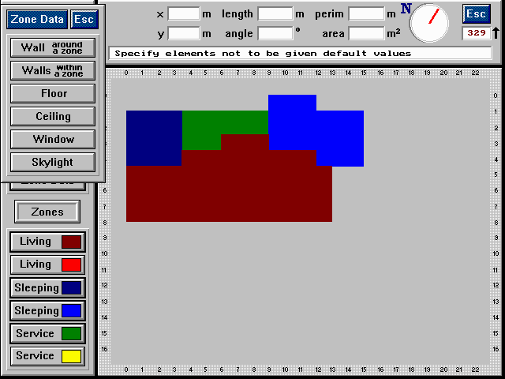
Making changes from the default values where appropriate

Slide 23
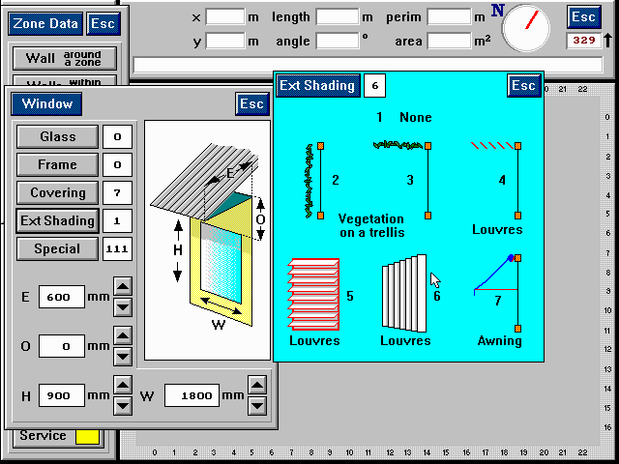
Dimensioning each window and selecting an external shading device where required

Slide 24
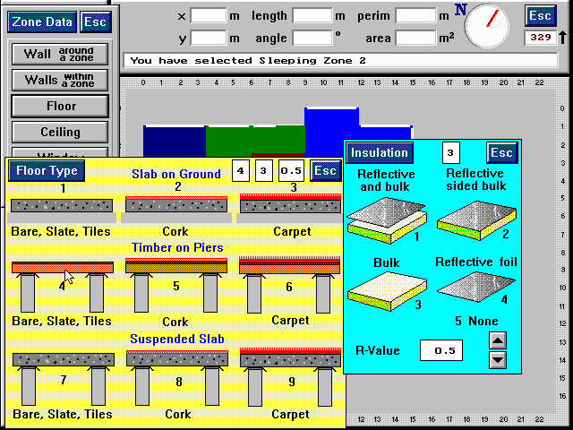
Making changes where the default does not apply, e.g. changing the floor covering

Slide 25
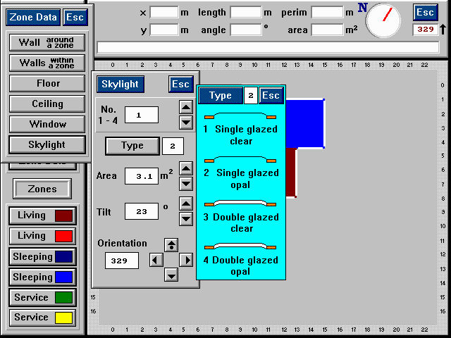
Adding skylights to a zone

Slide 26
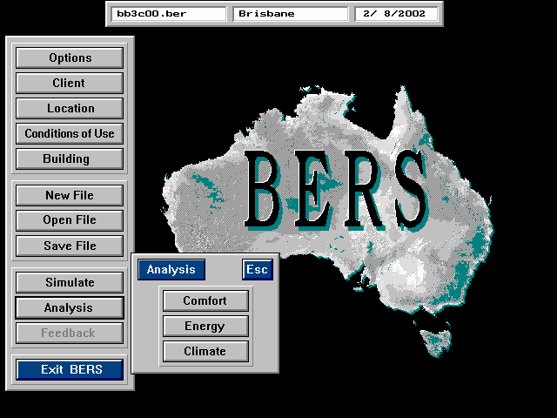
Simulating and analysing performance

Slide 27
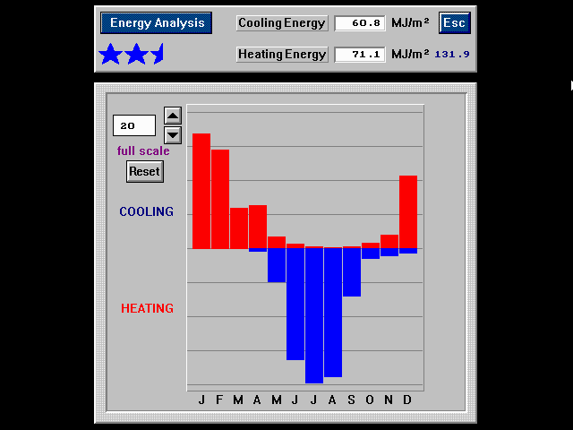
Initial assessment result

Slide 28
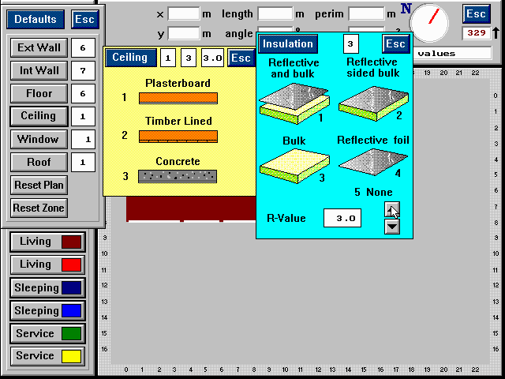
Making changes e.g. adding insulation

Slide 29
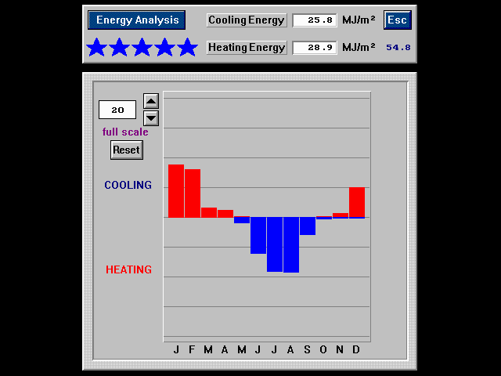
New assessment result

Slide 30
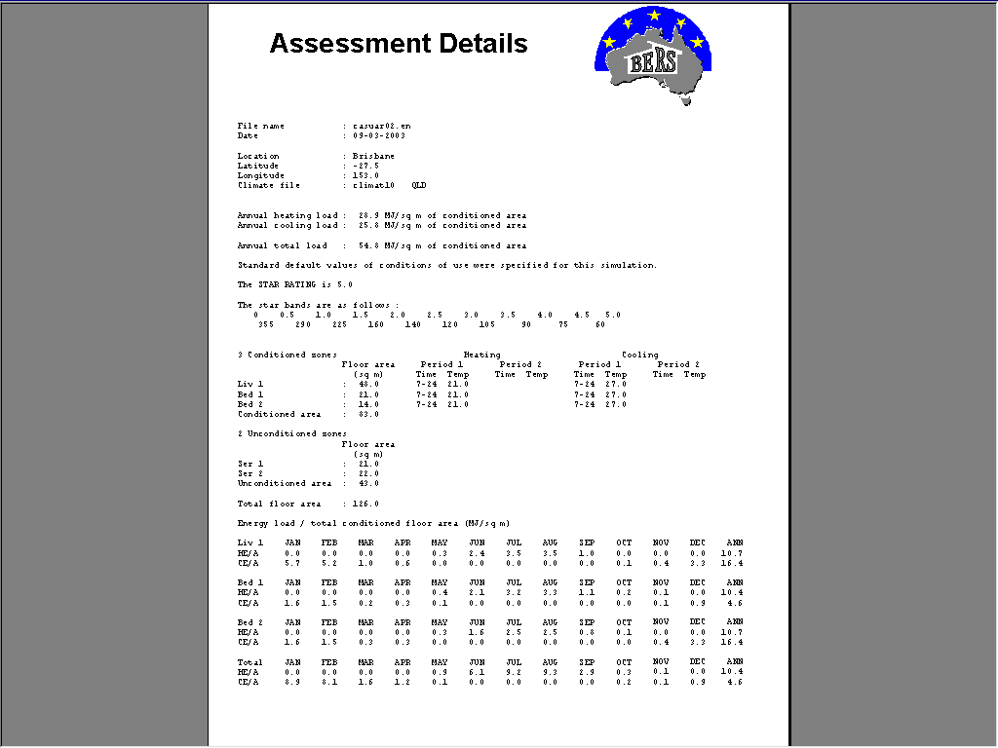
Print out of energy performance

